Slide 1

Eldert Grootenboer
Technology Lead
Integration beyond point to point; Implementing integration patterns using Azure

Slide 2
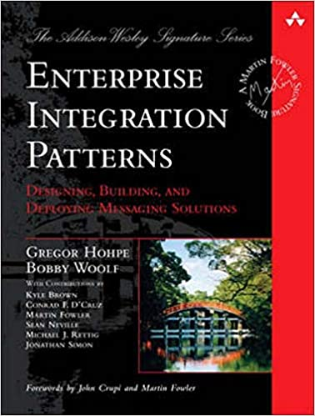
Enterprise Integration Patterns
https://www.enterpriseintegrationpatterns.com/

Slide 3
What are integration patterns
Recurring scenarios
Abstract
Reusable
Notes:
Patterns are accepted solutions to recurring problems within a given context.
They are abstract enough to apply to most integration technologies, but specific enough to provide hands-on guidance to designers and architects.
Patterns also provide a vocabulary for developers to efficiently describe their solution.

Slide 4
Why use integration patterns
Don’t reinvent the wheel
Use experts’ experience
Standards

Slide 5
Integration patterns on Azure

Slide 6
Azure Integration Services
Service Bus
Event Grid
API Management
Logic Apps

Slide 7
Azure Integration Services
Compose using different services
Various options
Azure Architecture Center

Slide 8
Let’s implement some patterns!

Slide 9

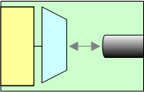
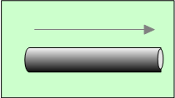
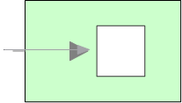
Simple integration
Message
Channel Adapter
Channel
Message Endpoint
Message
Notes:
Channels are one-way
Which means communications are asynchronous
To model request/response use two channels
Applications are independent of the messaging system
So you need adapters that are able to take application specific
data and create a message and send it to a channel.
At the other side you need Message endpoints that can receive a message
From a channel and pass it to an application in an application specific way.
These are the glue components to bind applications to the messaging system.
If an application changes, then the adapter or endpoint needs changing
Isolates change across the system.

Slide 10
Process Manager

Slide 11
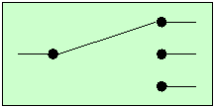
Message Router
Message
Channel Adapter
Channel
Message Router
Message Endpoint
Message
Notes:
Channels are one-way
Which means communications are asynchronous
To model request/response use two channels
Applications are independent of the messaging system
So you need adapters that are able to take application specific
data and create a message and send it to a channel.
At the other side you need Message endpoints that can receive a message
From a channel and pass it to an application in an application specific way.
These are the glue components to bind applications to the messaging system.
If an application changes, then the adapter or endpoint needs changing
Isolates change across the system.

Slide 12
Pipes and Filters
Verify Status
Message
Channel Adapter
Filter
Channel
Message Router
Message Endpoint
Message
Notes:
Channels are one-way
Which means communications are asynchronous
To model request/response use two channels
Applications are independent of the messaging system
So you need adapters that are able to take application specific
data and create a message and send it to a channel.
At the other side you need Message endpoints that can receive a message
From a channel and pass it to an application in an application specific way.
These are the glue components to bind applications to the messaging system.
If an application changes, then the adapter or endpoint needs changing
Isolates change across the system.

Slide 13
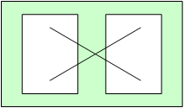
Message Translator
Message
Channel Adapter
Channel
Message Translator
Message Endpoint
Message
Notes:
Channels are one-way
Which means communications are asynchronous
To model request/response use two channels
Applications are independent of the messaging system
So you need adapters that are able to take application specific
data and create a message and send it to a channel.
At the other side you need Message endpoints that can receive a message
From a channel and pass it to an application in an application specific way.
These are the glue components to bind applications to the messaging system.
If an application changes, then the adapter or endpoint needs changing
Isolates change across the system.

Slide 14
Pipes and Filters
Notes:
The inclusion of the translator works for now
But what if there are other steps that need to take place, for example if the message has been signed and encrypted then we need to verify the signature and decrypt message.
Signature verification and decryption are common processes
We don’t want to hard code these into endpoints or the translator. We want to reuse.
A pipes and filters architecture allows us to do this.
The message passes through a number of components that process the message (filters)
They send the message down the pipe (channel) they are connected to.
They all deal with the same message/channel abstraction
They can be composed flexibly depending on the circumstance

Slide 15
Message Router
Notes:
We can now send a message down a channel and apply various processing/filtering steps.
Each filter is connected to an incoming and an outgoing channel
But the endpoints are hard coded.
This is not flexible
What if an endpoint changes?
Introduce a Router
A router knows where to send a message
E.g. a Content-Based Router could use
Message type (in headers)
Message content (in body)
Or a Context Based Router
Receives context information from a central configuration location
For example a ‘testing’ context could route differently to a ‘production’ context.

Slide 16
Publish-Subscribe Channel

Slide 17
Almost done…

Slide 18
Key take-aways
Integration patterns allow to solve recurring challenges
Azure has a wide variety of services to implement these patterns
Choose the right services, especially with complex patterns
Notes:
Summary
Integration patterns form a common language that can be used in integration projects
These patterns are widely used within BizTalk and other integration platforms
BizTalk Server 2004 provides a number of pattern implementations out of the box
Many other patterns can be implemented easily within BizTalk
Patterns to aggregate, or resequence messages can be complex to implement, but sample implementations are available

Slide 19



Thank You!
@egrootenboer
eldert@eldert.net
https://www.linkedin.com/in/eldert-grootenboer
Notes:
Rustig praten
Intonatie

